Slide 1
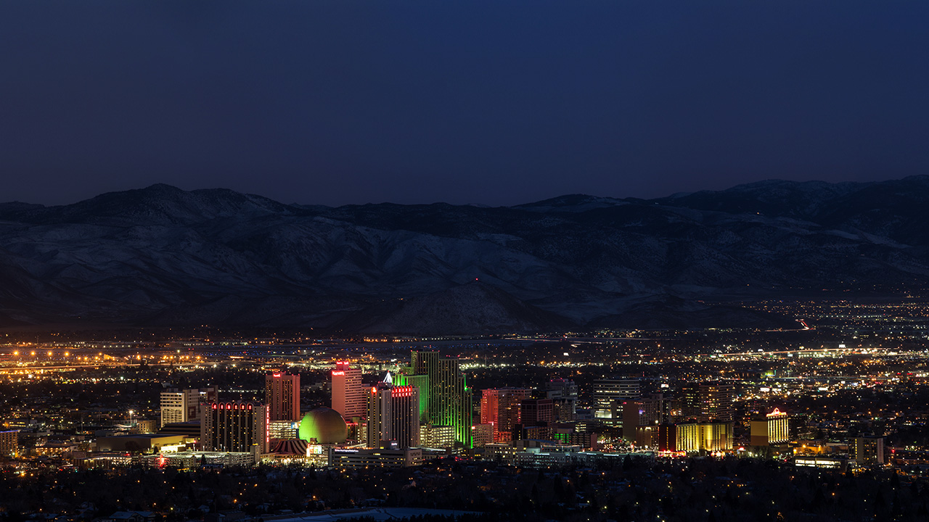



Built for Zero - Update 7.1.20

Slide 2




Built for Zero Teams
Regional Core Team Members
Dana Searcy | Washoe County | Community Lead
Catrina Peters | Washoe County - HSA | Data Lead
Monica Cochran | City of Reno | Continuum of Care
Hettie Read | City of Reno | Continuum of Care and HMIS
James Rundle | City of Sparks | Representation from all jurisdictions
Elizabeth Pope | Veteran Affairs | VA By-name List & Coordinated Entry
Chris Stadler | Veteran Affairs | Participated in Built for Zero in the past
Regional Stakeholders
Eric Brown | Washoe County
Kate Thomas | Washoe County
Kevin Dick | Washoe County Health District
Sheriff Darin Balaam | Washoe County Sheriff’s Office
Chief Jason Soto | City of Reno & City of Reno Police
Neil Krutz | City of Sparks
Chief Pete Krall | City of Sparks Police
Mike Kazmierski | EDAWN
Alex Stettinski | BID

Slide 3
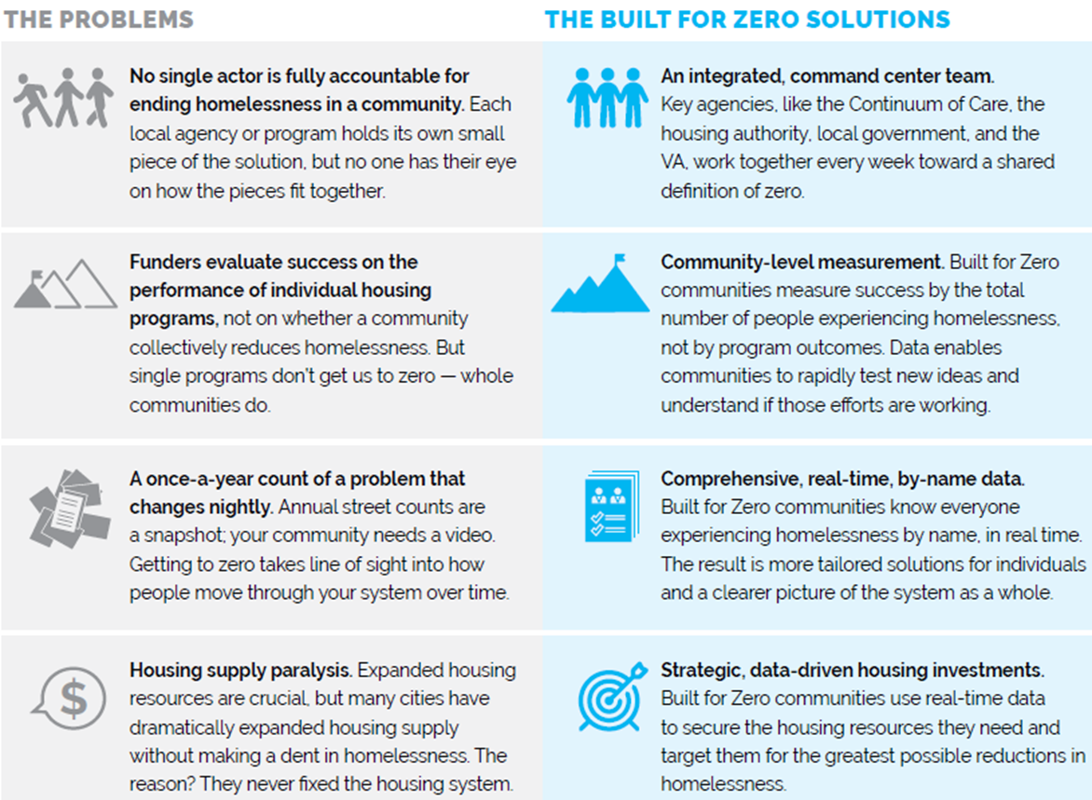
How do Built for Zero communities work differently?

Slide 4
Work We’ve Completed
Orientation
Community Inventory – Initial Assessment
    Outreach Inventory
    Provider Inventory
    By-Name List Scorecard
Action Plan Drafted

Slide 5
By-Name List Scorecard

Slide 6
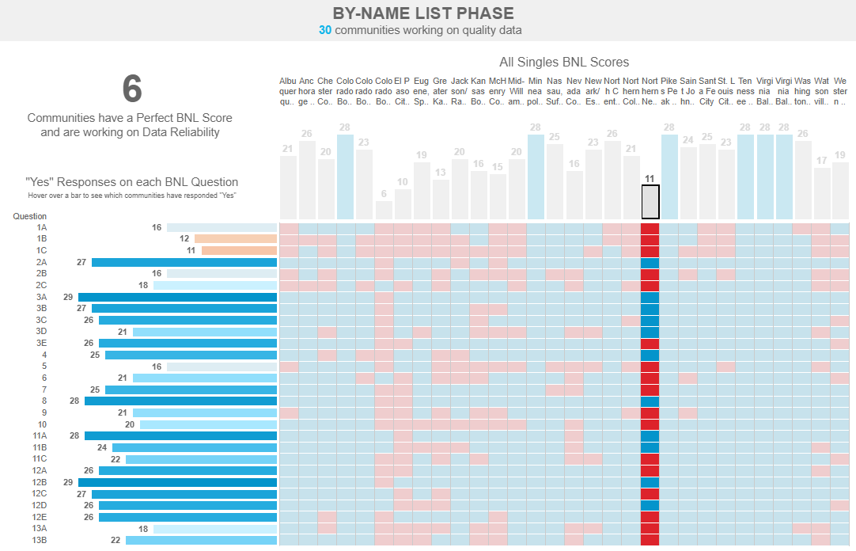
Initial Assessment Results

Slide 7
Aligning Efforts
Need: Develop a Regional Homelessness Plan
  Regional Leaders and Partners
  Continuum of Care
  Homeless Services Providers
  Outreach and Advocacy Groups
Built for Zero serves as:
  A regional collaboration platform to help facilitate conversations and align efforts and strategies
  An comprehensive think tank for ideas/possible solutions

Slide 8
Next Steps
Track A:
  Action Plan: Establish workgroups and begin work in 5 initial focus areas of the Action Plan
      Data Systems / By-Name List
      Policies & Procedures
      Provider Engagement
      Outreach Coverage & Coordination
      Leadership Alignment & Planning
  Community Inventory: gather additional detail
  Community Dashboard: Data Review
Track B:
  Regional Homelessness Solutions Matrix
    Ex: Shelter options for couples, Safe Camps, Relocating the Men’s Shelter

Slide 9
We need your help!
Support staff in their Built for Zero efforts
Support data based decision making to improve our community
Provide input/direction for the Regional Homelessness Solutions Matrix

Slide 10
Dana Searcy, dsearcy@washoecounty.us

